Slide 1

The Rise, Fall, and Future of
By: Anantha Dasari

Slide 2
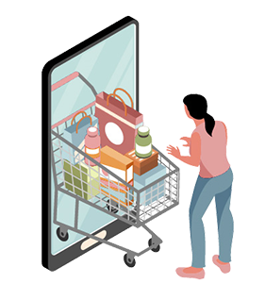
Executive Summary
Blinkit offers a variety of products, including Groceries, Daily Essentials, Ready-to-Eat and Frozen Foods, Pharmacy and Health Products, Office and Stationery Supplies, Pet Supplies, and Emergency Deliveries. It is available in over 28 cities across India.
Ordering Process: Customers use the Blinkit app to purchase and schedule deliveries, which Blinkit employees fulfill.
Founded in 2013 by IIT graduates Albinder Dhindsa and Suresh Kumar.
Aim to fill the gap in the unstructured hyperlocal delivery market.
Vision to provide a single platform for local delivery needs, simplifying grocery, medical, and restaurant logistics.

Slide 3
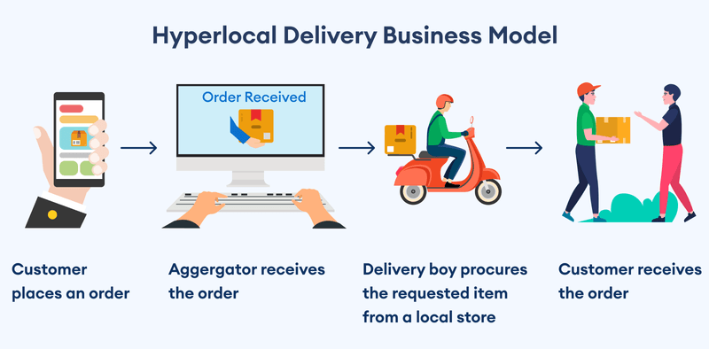
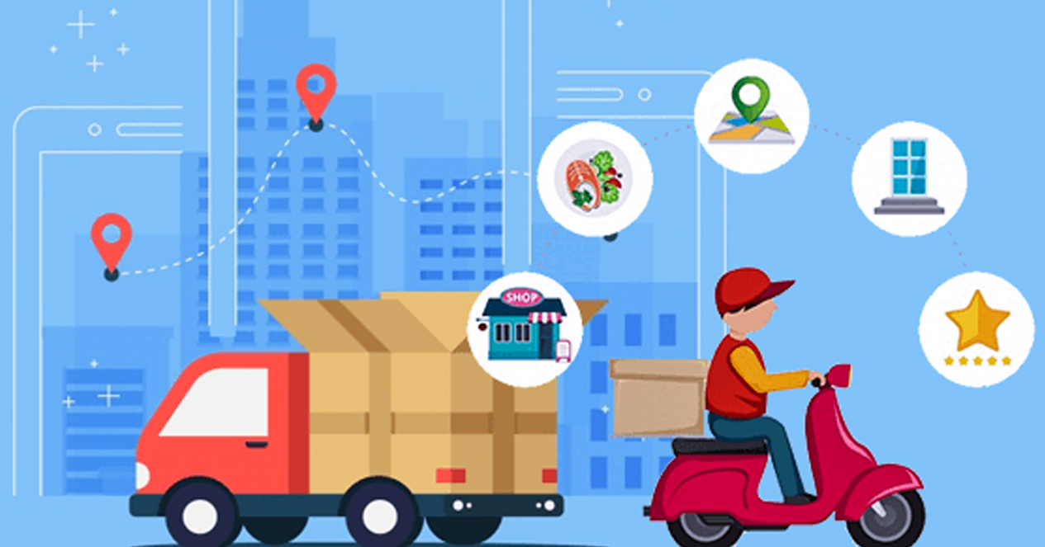
Business Model
Model: Hyper-Local On-Demand Logistics
Connects customers with nearby grocery stores for easy online ordering.
Objective:
Eliminates the need for customers to visit stores by providing doorstep delivery.
Operations:
No Warehouses: Relies on local grocery stores for inventory.
Delivery Process: Blinkit delivery agents collect items from partner stores.
Ordering Channels: Available through the Blinkit app and website.
Advantages:
For Stores: Increases their customer orders.
For Blinkit: Earns commissions on each transaction.

Slide 4

Key problems: Outline
Core Problem:
Blinkit faces demand variability and delivery inefficiency in its operations.
Why This Matters?
Customer Impact: Frequent stockouts, delayed deliveries, and inconsistent service.
Company Impact: Increased operational costs, potential loss of market share, and brand reputation risk.
Employee Impact: Unpredictable work schedules and increased stress among delivery personnel.
Stakeholders Affected:
Customers, Blinkit Management, Delivery Personnel

Slide 5
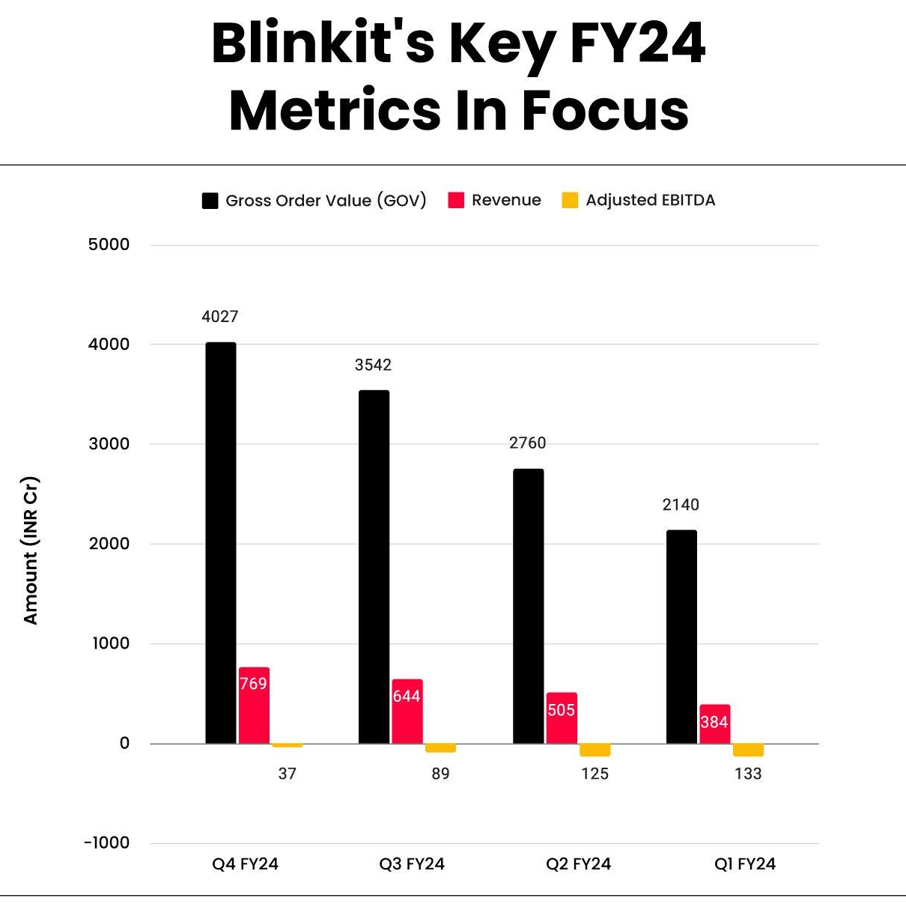
Challenges and Controversies
Recent Setbacks: Blinkit has stopped services in several major cities after investing over INR 600 Cr in growth in the last few months.
Key Challenges:
Quality Issues: Customers are complaining about product quality and freshness, leading to efforts to improve standards.
Delivery Delays: Many delays occur during busy times, causing customer dissatisfaction.
Price Discrepancies: Customers have noticed differences between app prices and final charges, which leads to frustration.
Worker Concerns: There are ongoing questions about the treatment, wages, and safety of delivery partners.
Urgency of the Situation: These problems threaten customer loyalty and the brand's reputation, which could impact Blinkit's future growth.

Slide 6
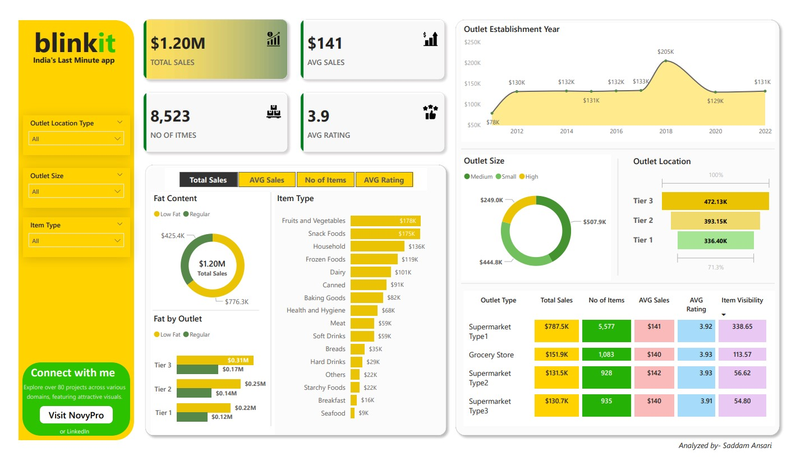
Approach
Data Collection
Historical Data Sources:
Sales Data: Transaction records to analyze past buying behavior.
Delivery Logs: Information on delivery times, routes, and delays.
External Factors: Weather data, local events, and market trends impacting demand.
Data Quality Assurance:
Ensure completeness and accuracy of data through validation techniques.
Identify and resolve missing data points to enhance reliability.

Slide 7
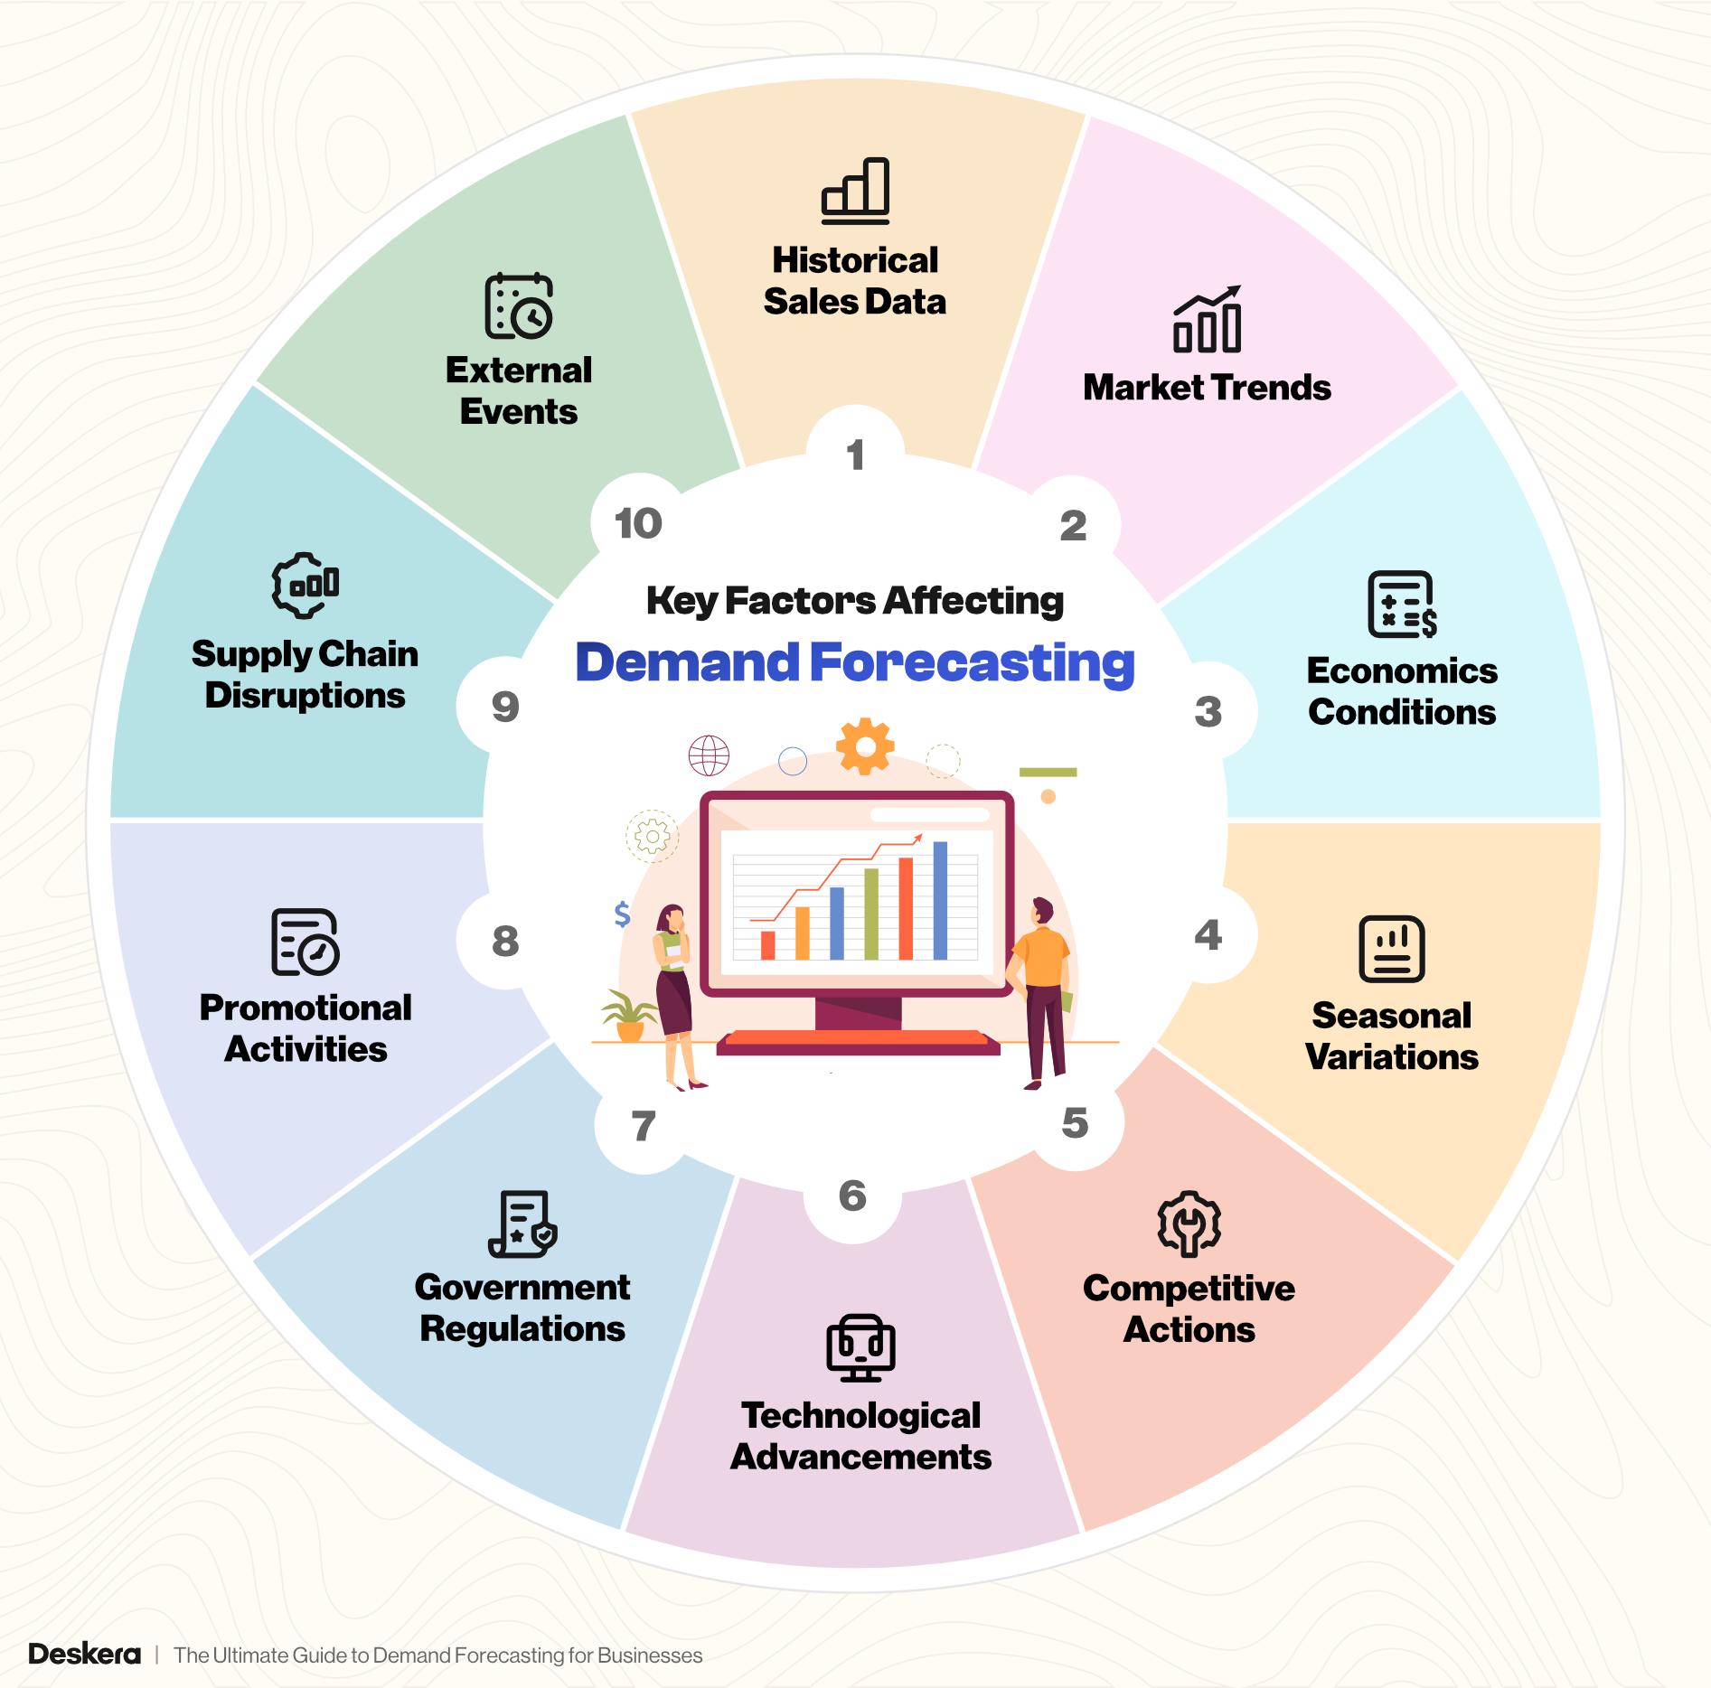
Analytical Techniques and Expected Outcomes
Demand Forecasting Techniques
Time Series Analysis: ARIMA and exponential smoothing.
Machine Learning: Random Forest and XGBoost.
Delivery Optimization Techniques
Clustering: K-Means for efficient grouping.
Routing: TSP and VRP for optimal delivery paths.
Visualization and Reporting
Power BI for interactive dashboards.
Expected Outcomes
Enhanced forecasting accuracy and delivery efficiency.

Slide 8
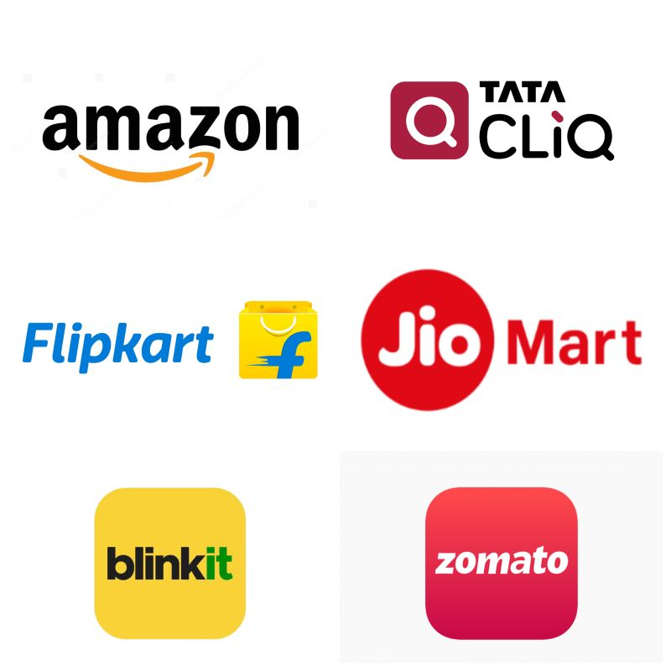
Navigating the Future of Grocery Delivery
Blinkit has evolved from a localized grocery delivery service in 2013 to a major player in the online grocery sector.
Key Takeaways:
Evolution and Adaptation
Transformation from Grofers to Blinkit highlights adaptability and diversification in response to market dynamics.
Expanded product offerings to cater to a wider customer base.
Competing with Giants
Positioned as a formidable competitor against
industry leaders like Amazon and Big Basket.
Holds a market share claim of 13%, establishing
itself as a significant player in the e-commerce landscape.

Slide 9
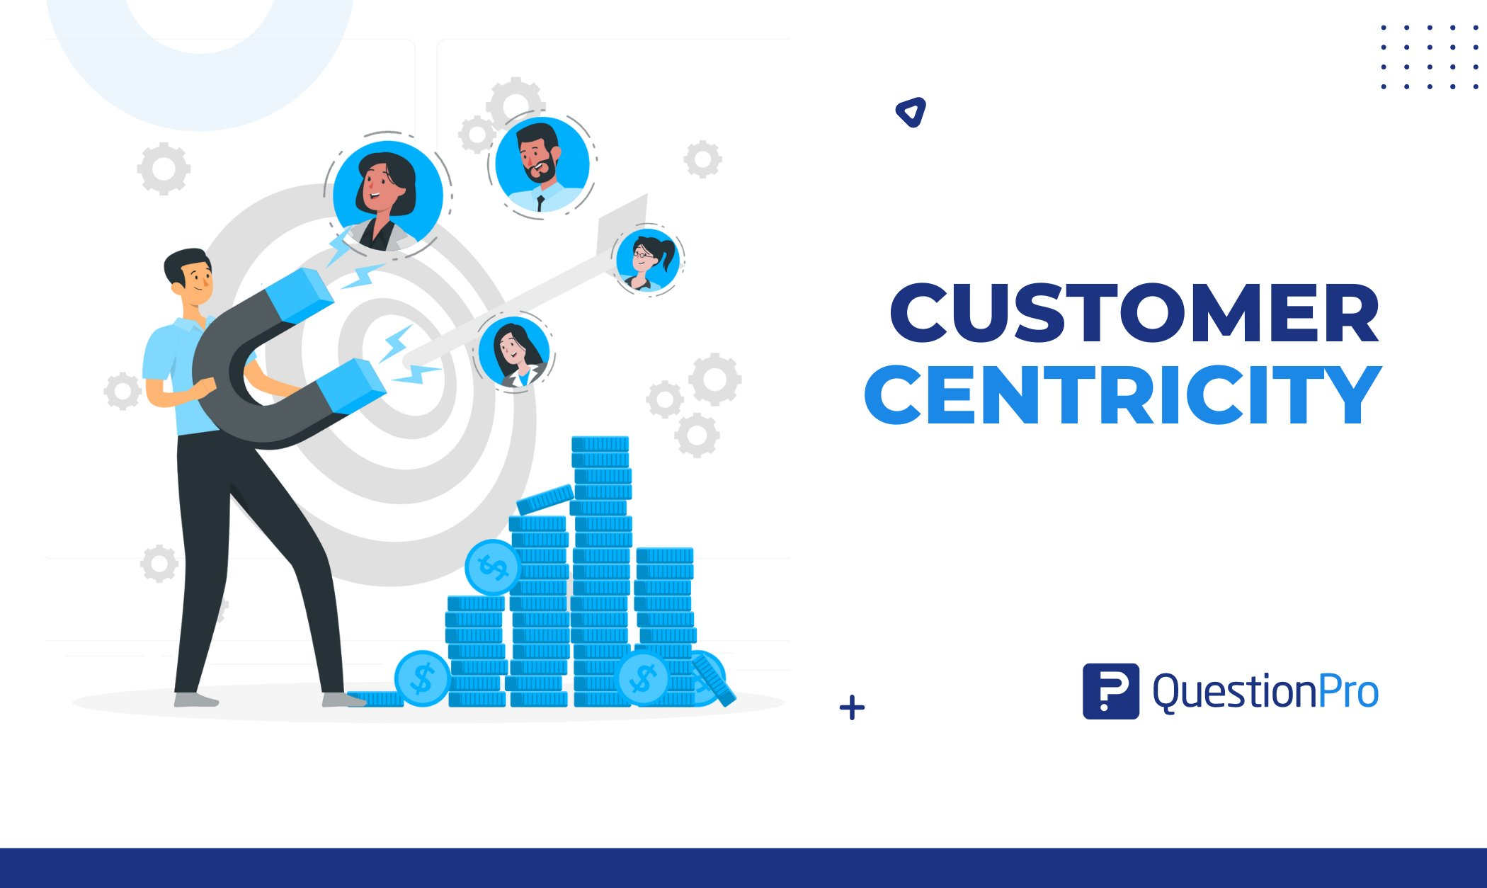


Customer-Centric Approach and Future Ambitions
Customer-Centric Approach
Strong focus on customer satisfaction through convenience, quality, and affordability.
This approach has been crucial in building a loyal user base.
Expansion and Ambition
Ambitious plans for expansion in terms of both service locations and product diversity.
Aims to multiply its size by 100 over the next five years, reflecting its long-term vision to dominate the Indian grocery delivery market.

Slide 10

Conclusion & Future Outlook
High Growth Potential:
Blinkit has established itself as a leader in hyper-local
delivery market with a strong focus on customer needs
Addressing Key Challenges:
Solving issues like delivery inefficiency and product quality
will strengthen Blinkit’s reliability and customer trust.
Future Opportunities:
With improvements in efficiency and scalability,
Blinkit could expand internationally, including into the U.S.
market, where demand for local delivery is strong.
Path to Global Impact:
By refining its model, Blinkit has the potential to set new standards in convenience and delivery worldwide.

Slide 11


